Slide 1

Modern Java

Slide 2

Agenda
Structura cursului si notare
Roadmap (LTS vs sts)
Interface default and static methods
Functional interfaces & Lambda expressions
optional
Stream api
Method reference
New date api
Java 9 to 17

Slide 3
1
Structura cursului si notare

Slide 4
Examen – 50%
2 puncte din oficiu
8 puncte examen
TestDome – platforma online
2. Laborator – 50%
1 punct oficiu
1 punct prezenta
2 puncte exercitii
6 puncte tema finala

Slide 5
2
Roadmap

Slide 6
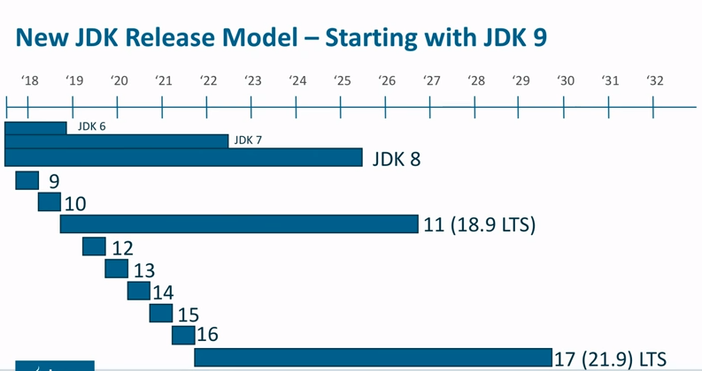
LTS - Long Term Support – every 3 years

Slide 7
3
Interface default & static methods

Slide 8
Why?
How?
Before Java 8, only public abstract methods were allowed in interfaces.
Adding new functionality to an existing interface was forcing all implementing classes to provide an implementation for the new method.
Java 8 introduces interface methods that can be static and default.
Just use the static and default keywords on the methods inside an interface!

Slide 9
4
Functional interfaces & Lambda expressions

Slide 10



Functional Interfaces
Any interface with any number of methods, but with only one single abstract method is called a functional interface.
We can use lambda expressions to instantiate them, avoiding anonymous class implementation.
Custom functional interfaces should be annotated with @FunctionalInterface. This annotation is not mandatory; however, it forces the interface to have one abstract method.

Slide 11

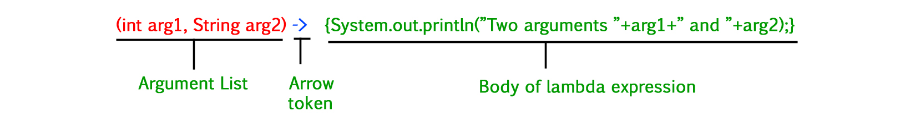
Lambda Expressions
What is a Lambda?
A Lambda is an anonymous function which can also be passed/returned from a method, just like other objects.
How do we use lambda expressions?
Instead of providing the implementation through an anonymous class, we can simply provide the behavior.
Syntax?

Slide 12
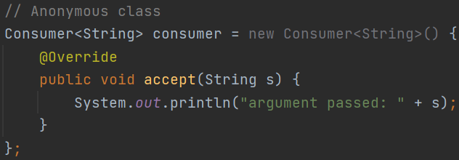
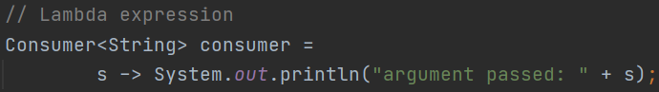
Comparison

Slide 13
Examples of Functional Interfaces
Name | Method
Function<T,R> | R apply(T t)
BiFunction<T,U,R> | R apply(T t, U u)
Consumer<T> | void accept(T t)
Predicate<T> | boolean test(T t)
Supplier<T> | T get()
Comparator<T> | int compare(T o1, T o2)
Runnable | void run()
Callable<V> | V call()

Slide 14
5
Optional

Slide 15

Optional
Optional<T> is a generic type of class, wrapping a variable which can be null.
Avoids throwing NullPointerException, while offering the possibility to execute some predefined actions instead.
Using Optional reduces boilerplate code.
Beside handling null, Optional also provides methods for filtering, mapping and getting the value.
Notes:
Old: if null else
Optional: isPresent()
ifPresent()
orElse()
orElseGet()
orElseThrow()

Slide 16
6
Stream API

Slide 17
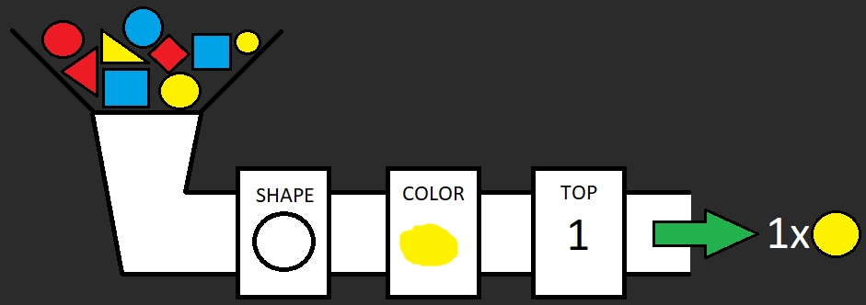
A stream is a sequence of elements on which we can perform intermediate operations until we get the desired result after a terminal operation.

Slide 18
Streams can be created from different sources – e.g. arrays or collections.
Most intermediate operations use functional interfaces
Stream API provides support for a lot of operations, such as filtering, mapping, iterating, matching, reducing and collecting.
Streams can get very complex.
Sequential streams are no faster than loops. Parallel streams, however, might improve performance.
Notes:
Examples:
creation
filter
map
count
anyMatch
limit
flatMap

Slide 19
7
Method reference

Slide 20
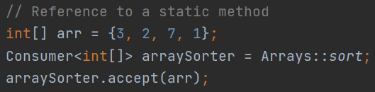
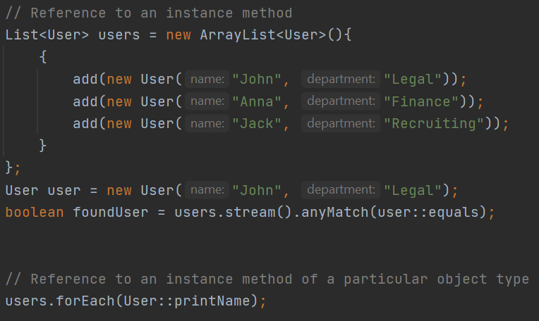
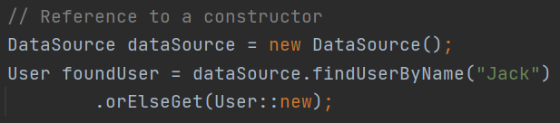
Method Reference
A shorter, more readable alternative for a Lambda expression which only calls an existing method.

Slide 21
8
New Date API

Slide 22
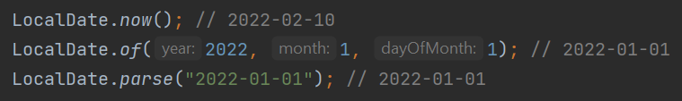


LocalDate
LocalTime
LocalDateTime

Slide 23



Instant
Used to represent the specific moment on the timeline.
Period
Used to measure time in years, months and days.
Duration
Used to measure time in seconds and nanoseconds.

Slide 24
9
Java 9 to 17

Slide 25

Modular System – Java 9
One of the main motivations here is to provide modular JVM, which can run on devices with a lot less available memory.
A modular system provides capabilities like OSGi framework's system. Modules have a concept of dependencies, can export a public API and keep implementation details hidden/private.
Truly encapsulate the code

Slide 26
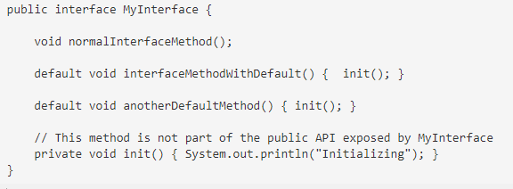
Private interface methods – Java 9

Slide 27
Local variable type inference – Java 10
var is a reserved type, not a keyword
Type is inferred at compile time and cannot be changed later
Only for local variables (not member variables, method parameters, return types)

Slide 28

String helper methods – Java 11
isBlank()
This instance method returns a boolean value. Empty Strings and Strings with only white spaces are treated as blank.
Lines()
This method returns a stream of strings, which is a collection of all substrings split by lines.
Repeat(int)
The repeat method simply repeats the string that many numbers of times as mentioned in the method in the form of an int
strip(), stripLeading(), stripTrailing()
Removes the white space from both, beginning and the end of string.

Slide 29
Switch expressions – Java 13
var result = switch(month) { case JANUARY, JUNE, JULY -> 3; case FEBRUARY, SEPTEMBER, OCTOBER, NOVEMBER, DECEMBER -> 1; case MARCH, MAY, APRIL, AUGUST -> 2; default -> 0; };

Slide 30
Instanceof pattern matching – Java 14
if (animal instanceof Cat) { Cat cat = (Cat) animal; cat.meow(); } else if (animal instanceof Dog) { Dog dog = (Dog) animal; dog.woof(); }
if (animal instanceof Cat cat) { cat.meow(); } else if(animal instanceof Dog dog) { dog.woof(); }

Slide 31
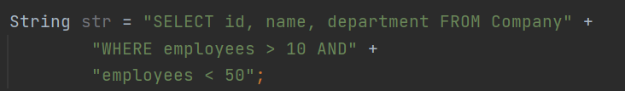
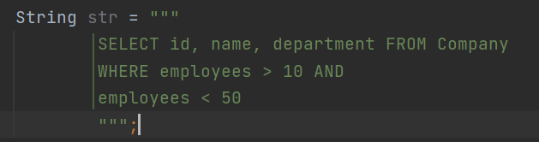
Text Blocks – Java 15
vs
Improves code readability

Slide 32
Sealed classes / interfaces – Java 16
public sealed interface Service permits Car, Truck { int getMaxServiceIntervalInMonths(); default int getMaxDistanceBetweenServicesInKilometers() { return 100000; } }

